Slide 1
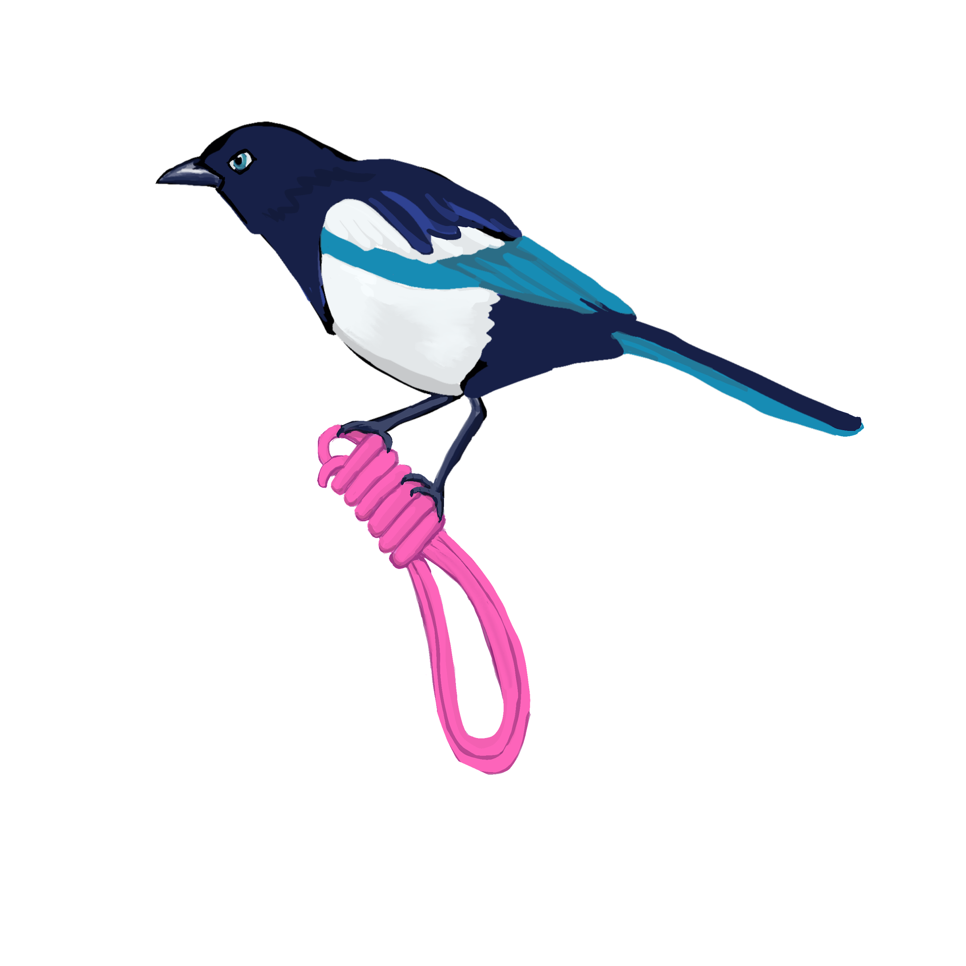
Gateway to Suspension
A guide to partials and suspension fundamentals by Magpie Kink Education
Notes:
Intro section

Slide 2
Who is Em?
(she/her)you can find her as Mz_Magpie on IG and Fetlife
Joined the PNW kink scene in 2010 started suspending in 2017
Organized Seattle Suspension (progressions) Rope group 2018-2020
Presented at Conception 2018, Subspace and BDSM discords.
Notes:
Intro section

Slide 3
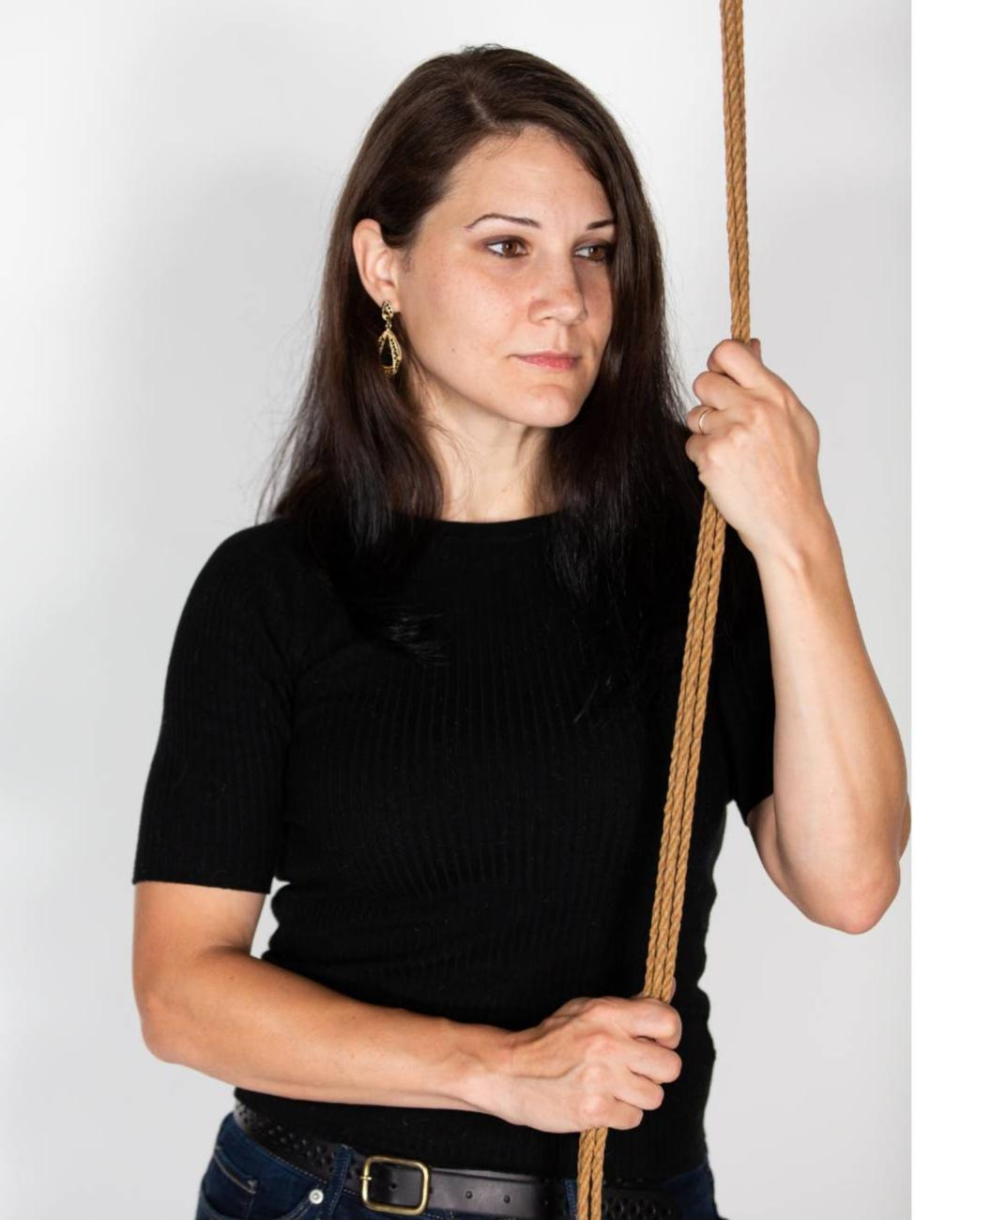
Who is Roxanne?
Roxanne (she/her) has been tying since 2016 and began topping suspension in 2018. Once a month, she co-hosts the Witchy Rope Enthusiasts Group where she demos simple ties and labs more creative ideas.
Notes:
Intro section

Slide 4
What we are covering:
Negotiation
Uplines and suspension gear
Suspension frames and hardpoints (brief)
Bondage anatomy: Blood flow and nerves (brief)
Bottoming skills
Beginning suspension ties (easy partials)
All of these could have been separate classes.… So be warned: it’s intense.
Notes:
Intro section

Slide 5
What we aren’t covering:
Single point suspensions
Inversions
Transitions/dynamic rigs.
TKs and other arm-loading harnesses
Using limbs as the primary upline (futos, strappados, single ankles, etc.)
All of these are advanced ties that require both the top and bottom to be skilled in suspension. We will not cover these things in this class, and we recommend you take several classes before attempting these on your own.
Notes:
Intro section

Slide 6
Why partials? These ties …
…give tops and bottoms a chance to learn how harnesses feel under tension
…teach essential skills to practice
…provide a safer environment to fail
Notes:
Intro section

Slide 7
Advanced floor work and body harnesses
Everyone:nerves and anatomy,
technical rigging
Tops: Upline management, load distribution, emergency descent
Bottoms: Triaging sensations
Core Skills
Suspension skills
Structured harnesses and advanced floor work
Rope skills: Single columns, tension, frictions
Communication skills: Communication, consent, boundaries
Everyone: nerve checks
Bottoms: Body awareness,
pain processing,
Tops: Body manipulation,
structure
Notes:
Intro section

Slide 8
You only get one body
Suspension is a dangerous activity, just like football or roller derby. It can have serious impacts on you and your partner’s body if you aren’t careful.
We encourage you to do lots of research so you know the potential dangers of this kind of play. You may find some things are outside of your risk profile, and that’s okay!
Make the right decision for you.
Notes:
Risk assessment

Slide 9
Hard on your bottom
Rope Harnesses involving arms:
Strappados
TKs/Box ties
Both Strappados and TKs require significant shoulder rotation and some flexibility, This increases the likelihood the tie will be unsustainable or injure your bottom.
Almost all the nerve injuries we see in rope incident reports relate to strappados and box ties. Ideally, look for ties that do not go to the maximum range of motion.
We recommend you don’t attempt any tie which requires shoulder rotation without receiving direct in-person instruction and extensive practice.
Notes:
If you see scapular winging, this is an indication that the shoulder is in a weakened position and vulnerable to injury. Test every bottom’s range of motion before you begin tying.

Slide 10
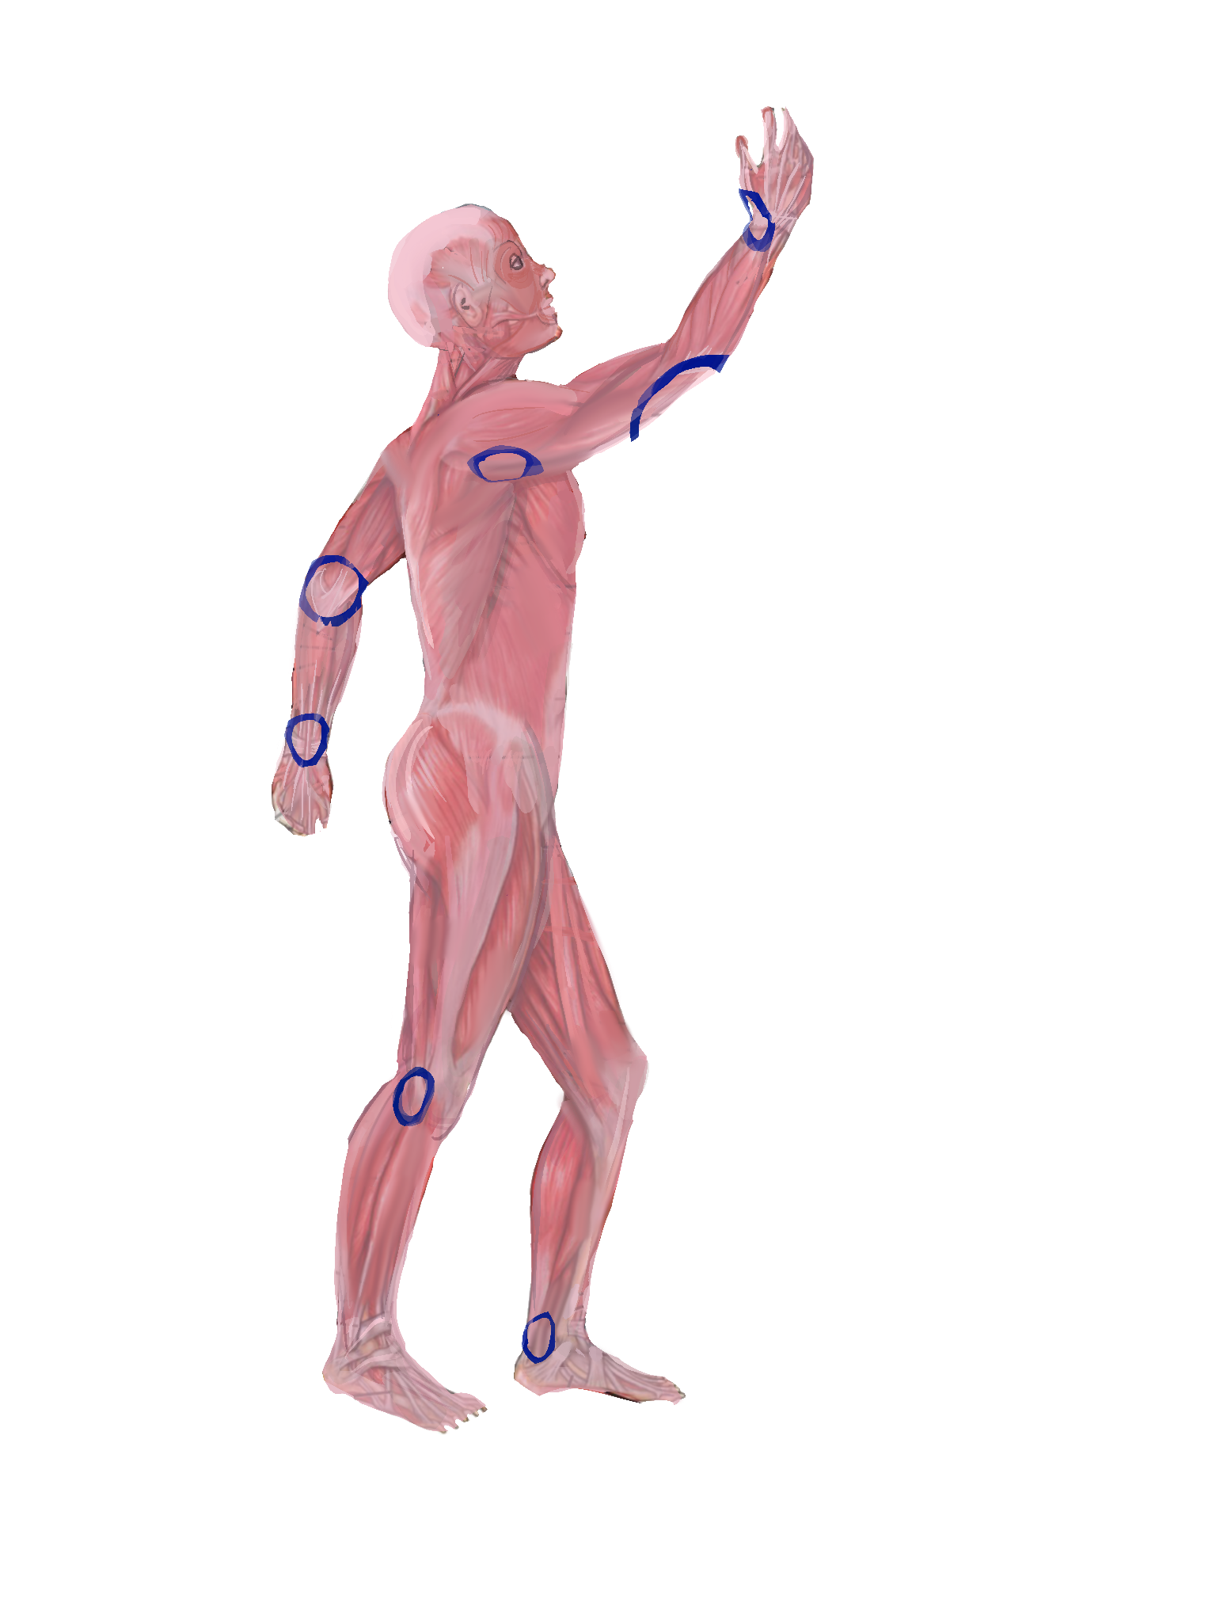
Conditions that affect suspension
Nerves
diabetes (peripheral neuropathy)
thoracic outlet syndrome (nerve impingement)
High or low blood pressure
Hyper mobility
Pregnancy
Tell your doctor you’re thinking about getting into “aerial arts” and see what they think!
Notes:
Risk section

Slide 11
Negotiating for suspension
Risk profiles and risk mitigation examples:
I only do suspension with people I’ve tied on the ground with first
I use synthetic uplines
I don’t do inversions without padding
I only do suspensions with a spotter or DM present
I don’t suspend with TKs because I’m not confident in my ability to tie them
Emergency plans:
Medical insurance
Emergency contacts
Notes:
Risk section- all of these are suggested risk mitigations for new riggers.

Slide 12
Negotiating for suspension
What do you both need for aftercare and post-play check-in?
How and when would you like to give/receive feedback?
Share how you are unique:
o Abilities: “I have very flexible shoulders” or “I can withstand inversions very well.”
o Limitations: “I have an injured left shoulder” or “Inversions make me nauseous.”
o Triggers: “Don’t cover my mouth with hands, gags, rope, cloth, etc.”
Notes:
Risk section

Slide 13
Nerves: A layman’s guide
Other less common nerve injuries include:
Thoracic outlet syndrome (look for winging of the scapula and weakness in arm)
brachial plexus (affected by shoulder straps and ties that go into the armpit)
Femoral nerve ( inner thigh) injuries, numbness in the front & outside of the thigh
Foot drop is caused by damage to the common peroneal nerve, just below the knee on the outside of the leg.
See a MD or PT for assessment and treatment!
Notes:
Anatomy section handcuff thumb can be prevented by tying noncollapsing ties, avoiding vulnerable areas, and not tying too tightly. ulnar which can be prevented by not tying rope over the upper arms, especially in positions where the nerve is fully exposed (i.g., rotated backwards)

Slide 14
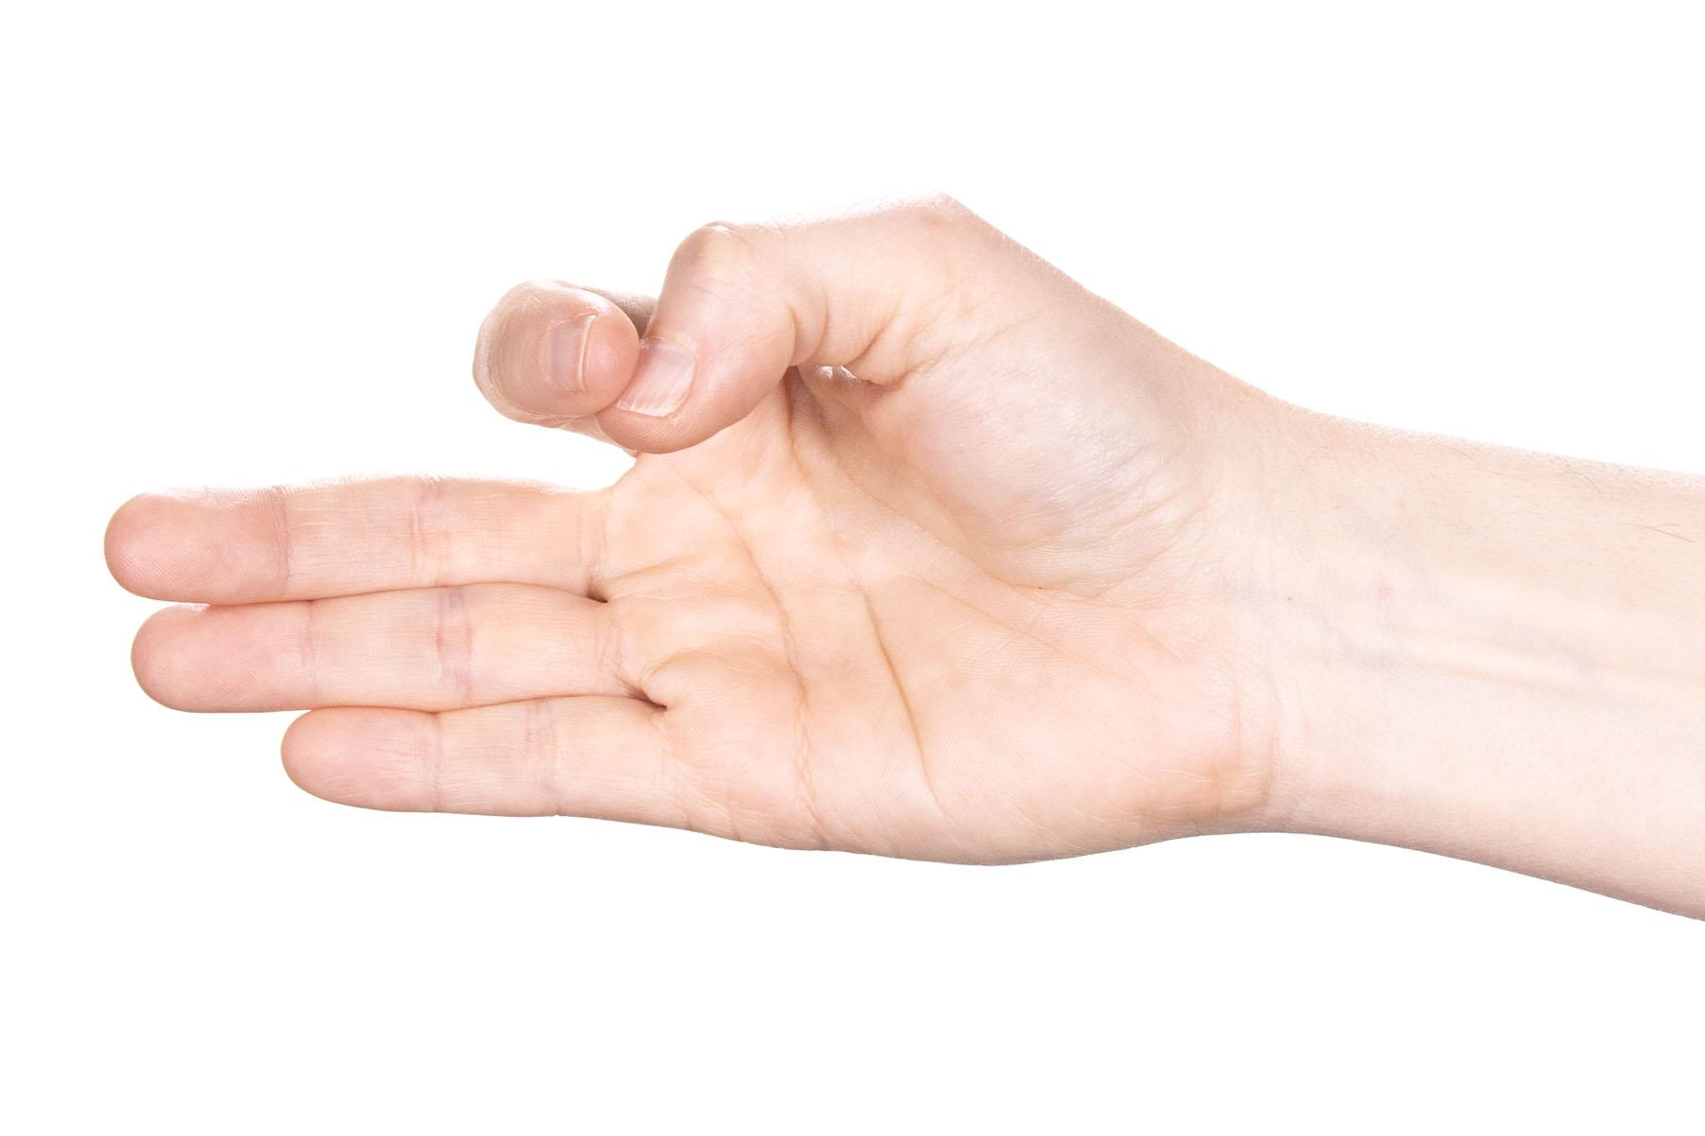
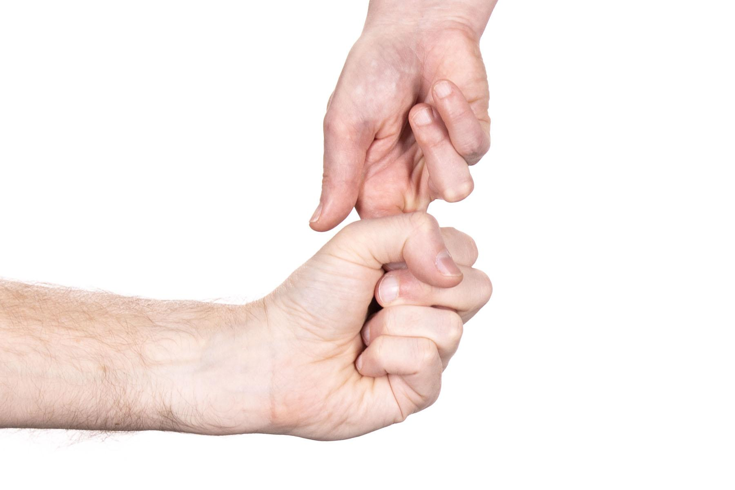
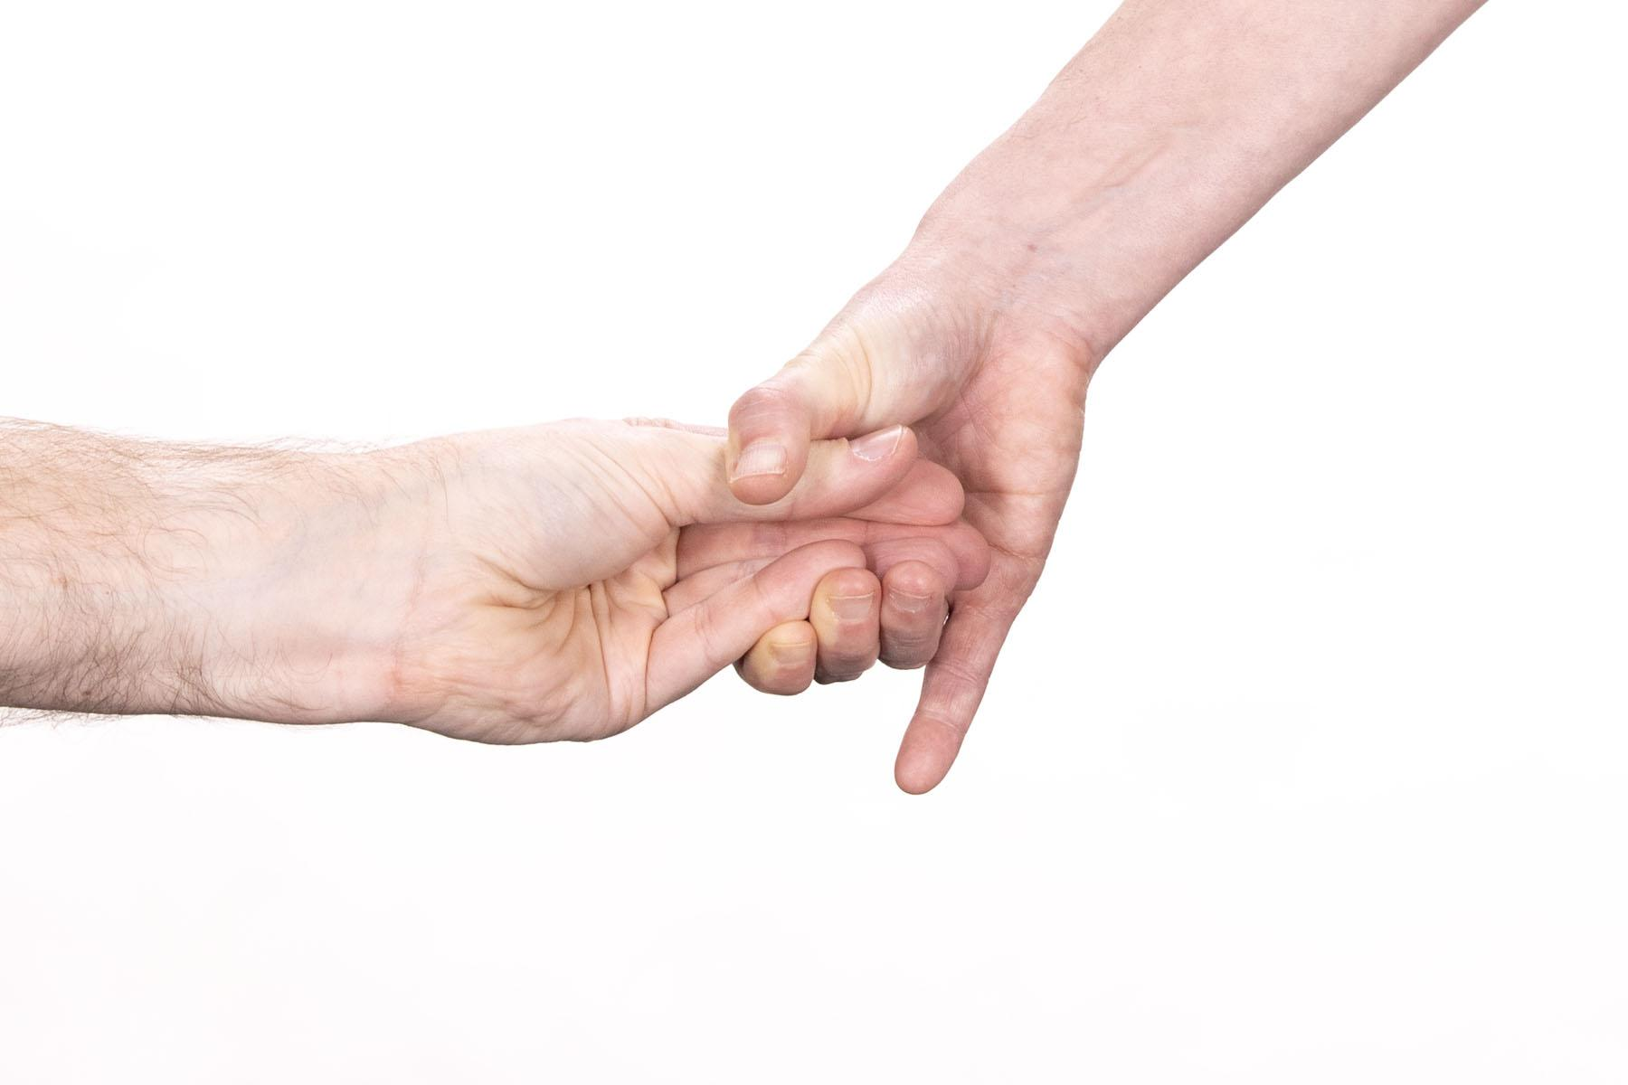
Nerve checks
Sensation Tests
Run index finger over back of thumb (down the length) to test radial
Run thumbnail against the inside of pinkie (down the length) to test ulnar.
Motor tests
Thumbs up against pressure - radial test.
Backwards wrist flexion for median.
Bottom grip test
Spread fingers against resistance
Notes:
Anatomy section

Slide 15
Nerves: A layman’s guide
Nerve Damage can be sensory (hot/cold/tingly/buzzing/sensation loss) Or functional (motor coordination).
The most common nerve injuries from rope are:
Handcuff thumb (radial nerve damage),
Wrist drop from (radial nerve damage)
Ulnar nerve compression, (upper arm compression)
See a MD or PT for assessment and treatment!
Notes:
Anatomy section handcuff thumb can be prevented by tying noncollapsing ties, avoiding vulnerable areas, and not tying too tightly. ulnar which can be prevented by not tying rope over the upper arms, especially in positions where the nerve is fully exposed (i.g., rotated backwards)

Slide 16
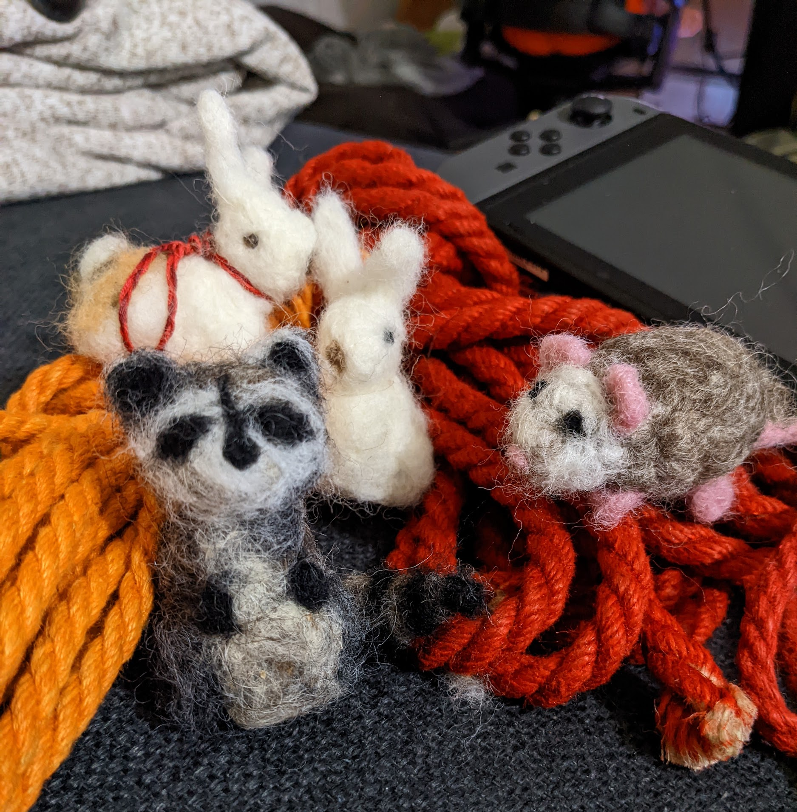
Body Rope types
Not safe for suspension
Sisal
Coconut
Cotton
Natural fiber ≤5mm
Safer for suspension
Hemp >5mm
Jute >5mm
Nylon
Posh
Hempx

Slide 17
Uplines
Critical uplines should have a high safety factor (10x factor or more).
Recommended uplines
Nylon
Posh
Hempx
Hemp >5mm
Notes:
Gear section

Slide 18
Suspension Gear
Climbing gear is commonly used for suspension. Climbing gear ratings are usually in kN, which is a unit to measure force.
1 kN is approximately 220 lbs.
To maintain a 10x safety factor for suspending a person who weighs 200 lbs, you need a rating of 10 kN or more.
ALWAYS CHECK THE RATING. There are lots of water bottle and keyring carabiners that will never hold up a person.
Notes:
Gear section

Slide 19
Rated climbing gear
Notes:
Gear section
Hand out gear now for class to look at

Slide 20
Questions?
Break Time!

Slide 21
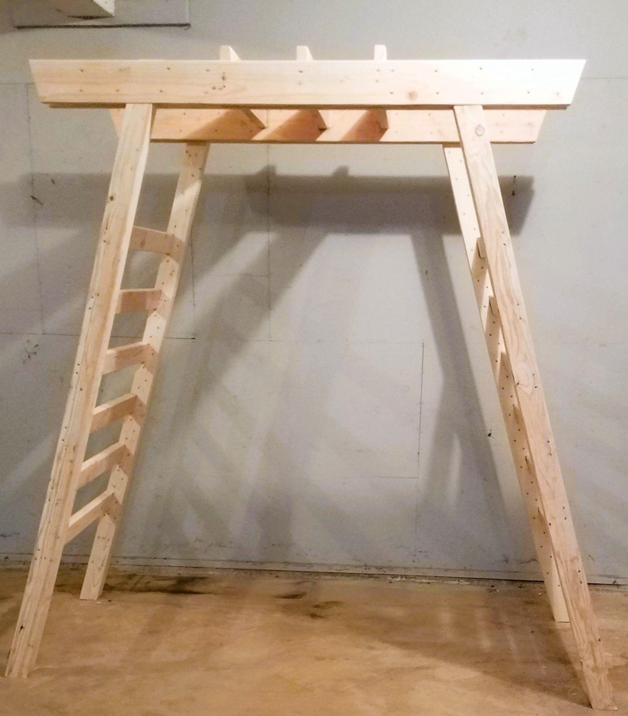
Suspension frames
Pagodas, aerialist A-frames, and tripods are all popular options due to their portability.
The key way most suspension frames fail are:
Legs splaying out
Tipping over (usually caused by user error, such as swinging)
Notes:
Gear section

Slide 22
Hard points
People might use the “Two big guys” test (jumping up and down on their upline to “test” the hardpoint). This just tells you it isn’t failing now, not that it won’t fail later. This test may even weaken the hardpoint.
Things to look for:
Hardpoints with rough edges that can cut your sling
I-bolts ( can become unscrewed)
Anything for which you don’t know the original purpose of the support.
Decorative beams (hollow or not attached to walls)
Notes:
Avoid the American Death Triangle (if you run the single rope in a triangle). Using one line on two hardpoints increases load on both rather than reducing it on both.

Slide 23
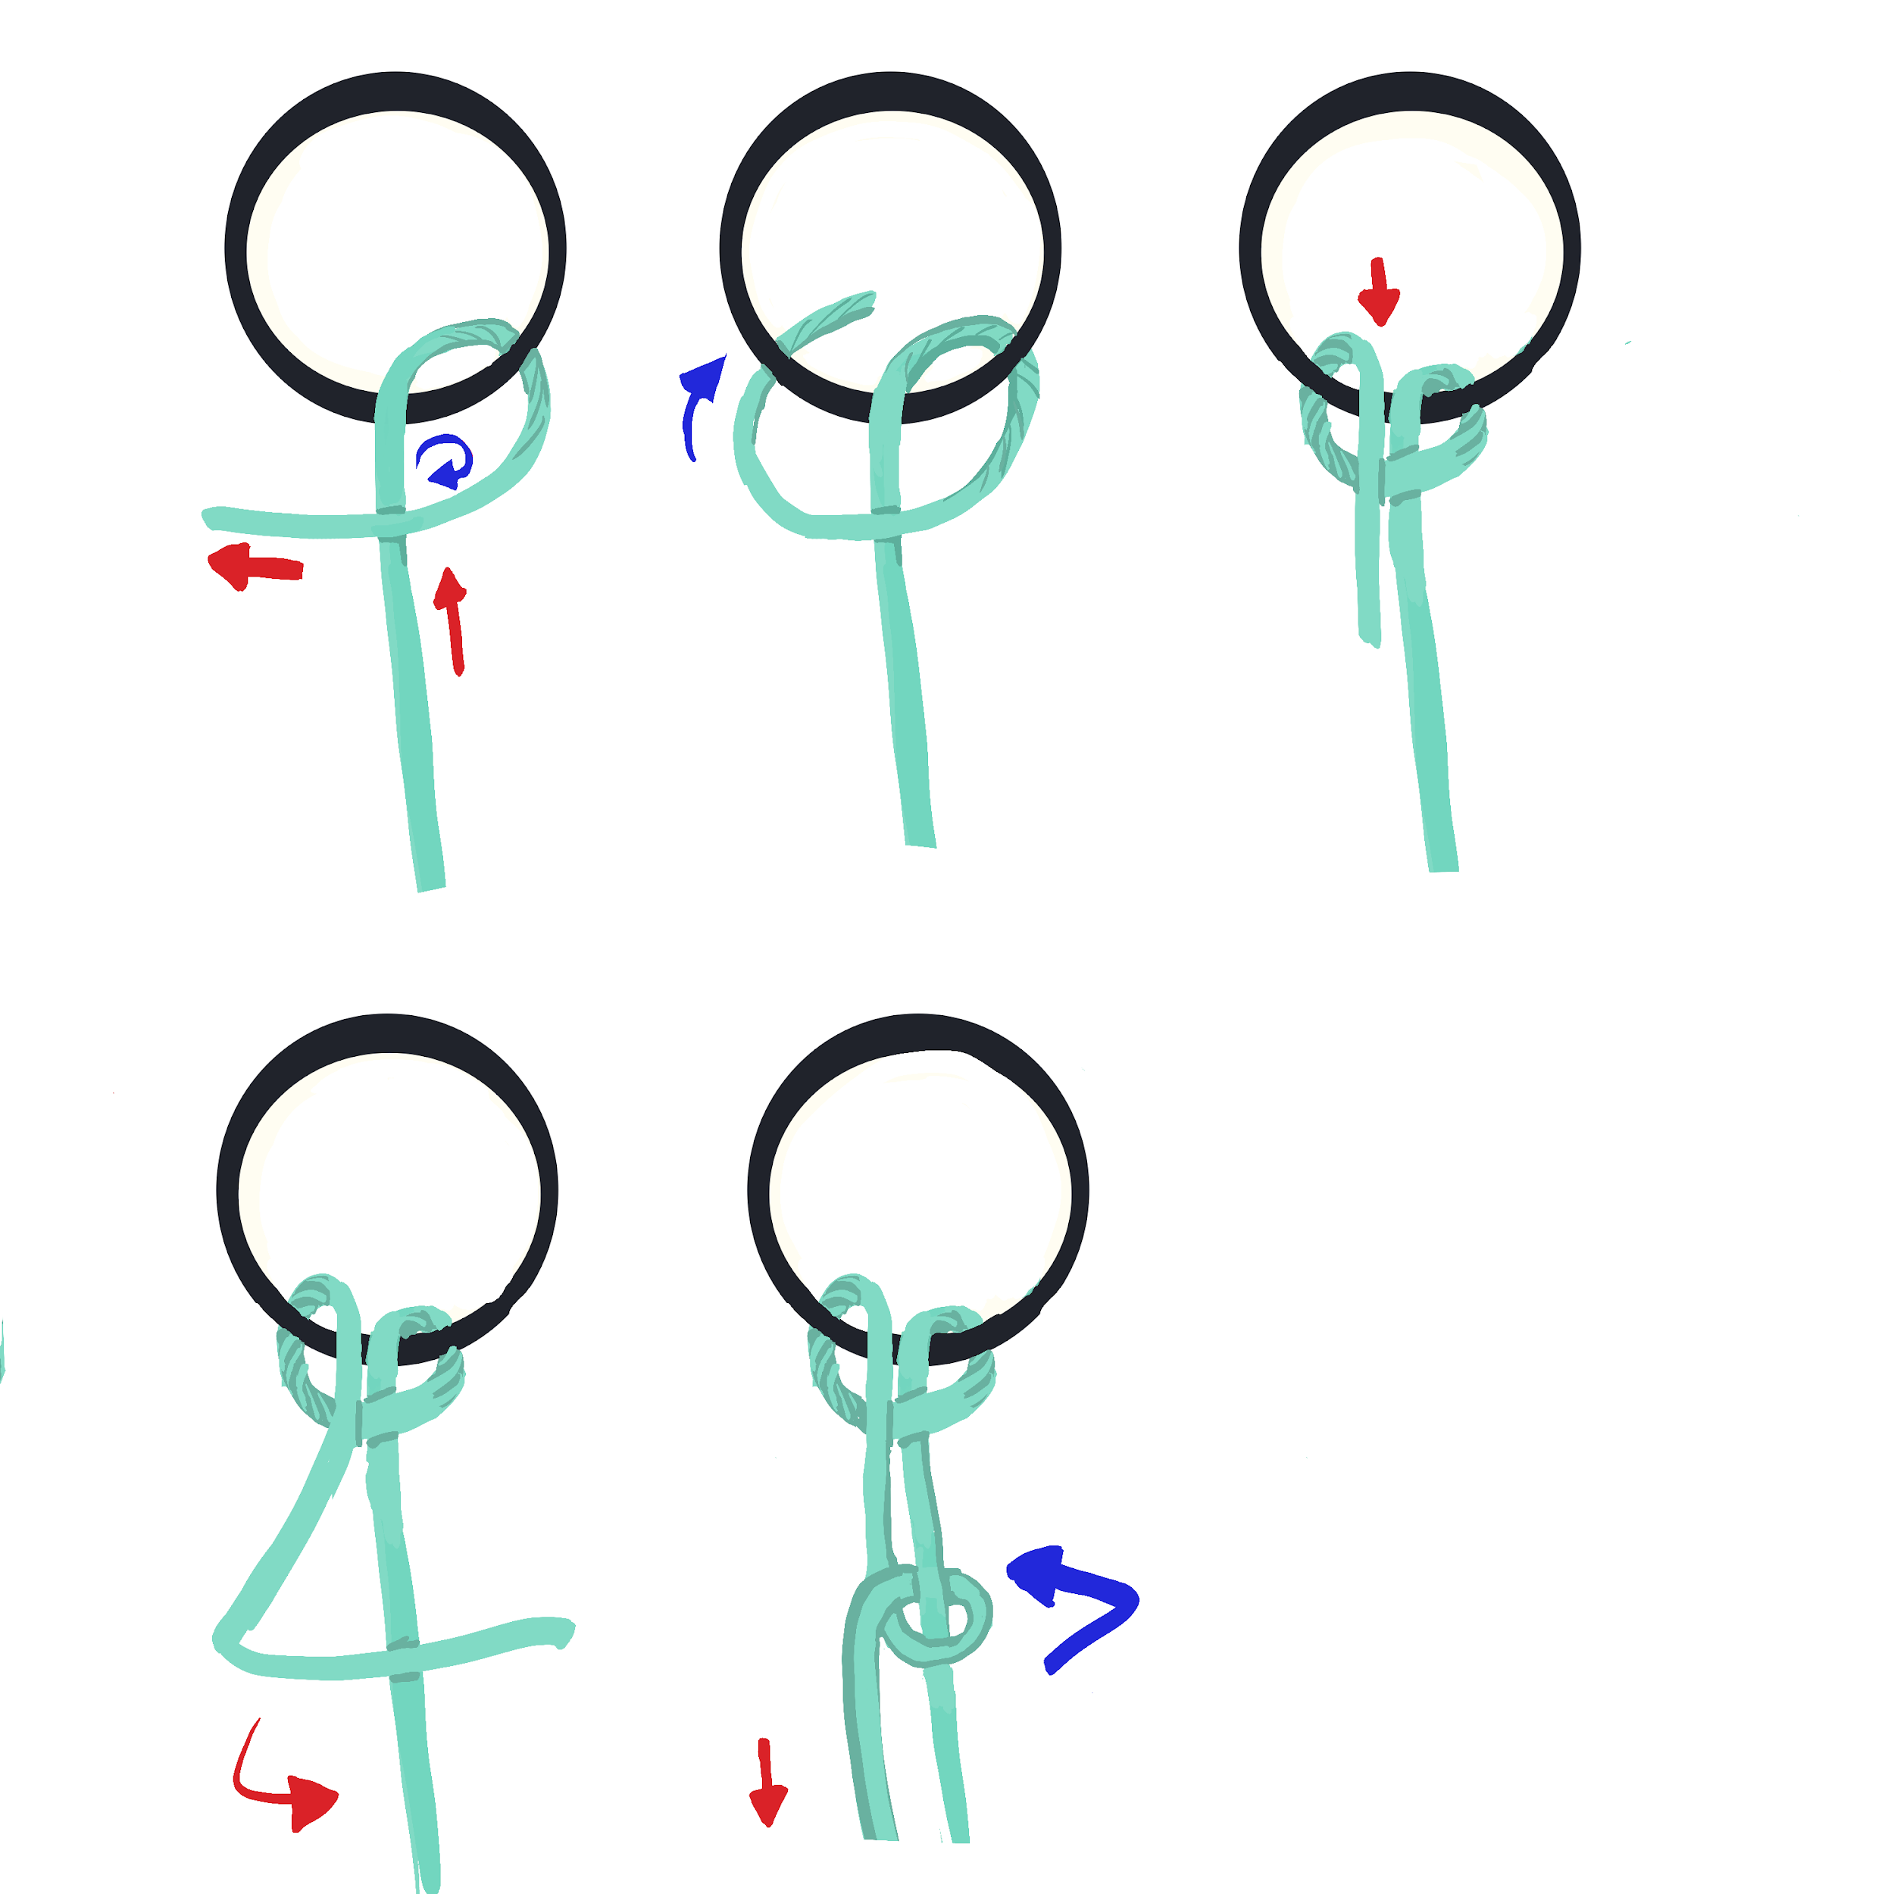
Munter Hitch
Pull rope through the ring
Pass underneath the ring
Circle the upline halfway (360 turn if wanted)
Pull through the ring
Friction below on upline
Notes:
Allows slow descent and easy hand break, without the munter your upline will undo itself rapidly

Slide 24
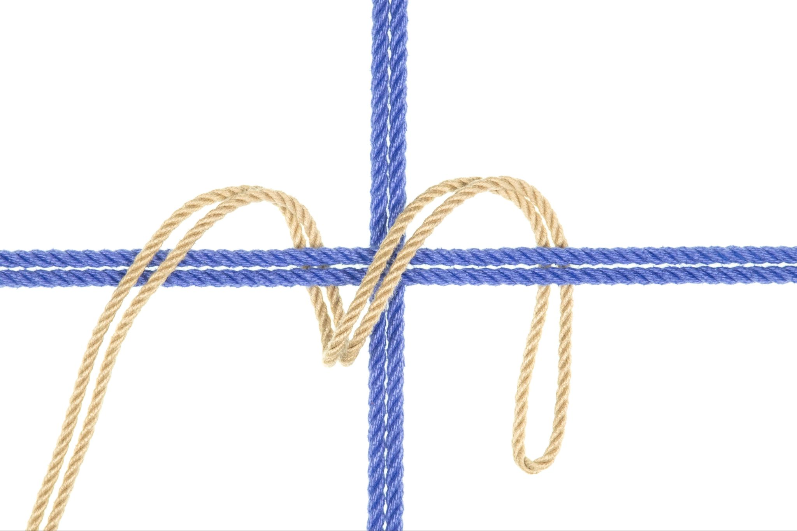
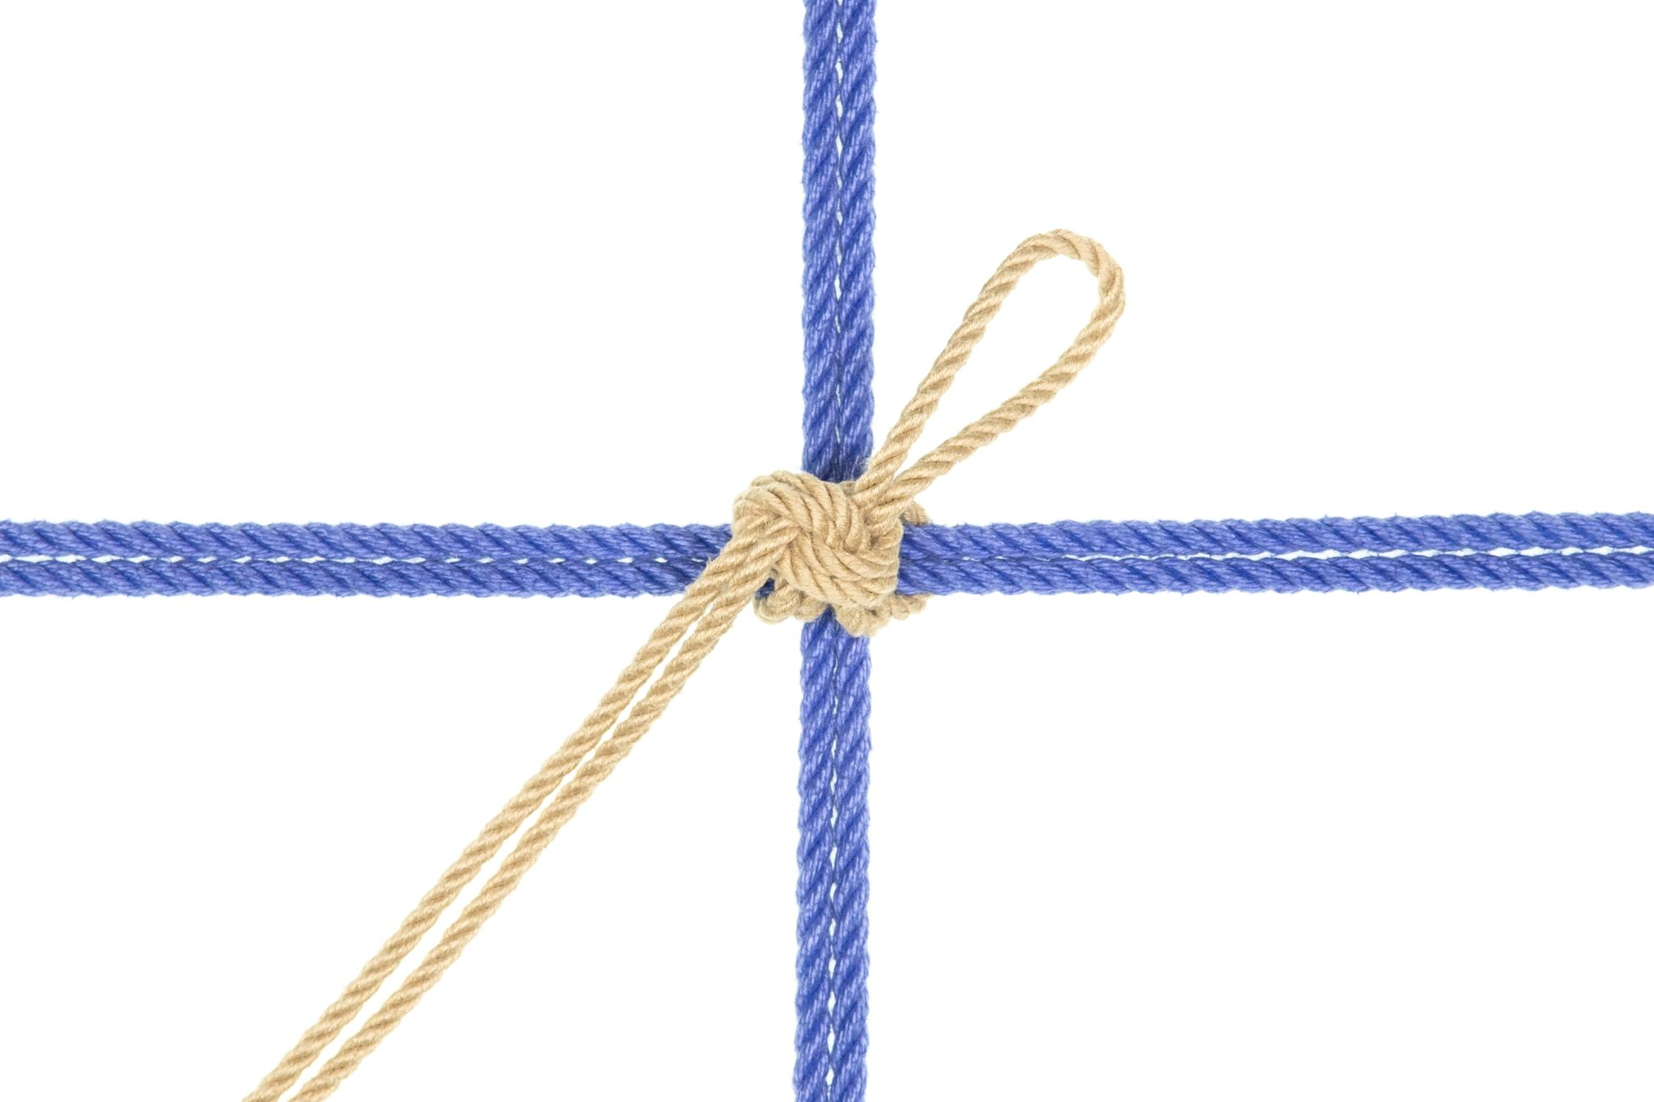
Attachments at a stem.
Begin by spiraling clockwise to capture both the right and left sides of the rope intersection.
Then tie off your single column leaving room on your bight for a carabineer or rappel ring

Slide 25
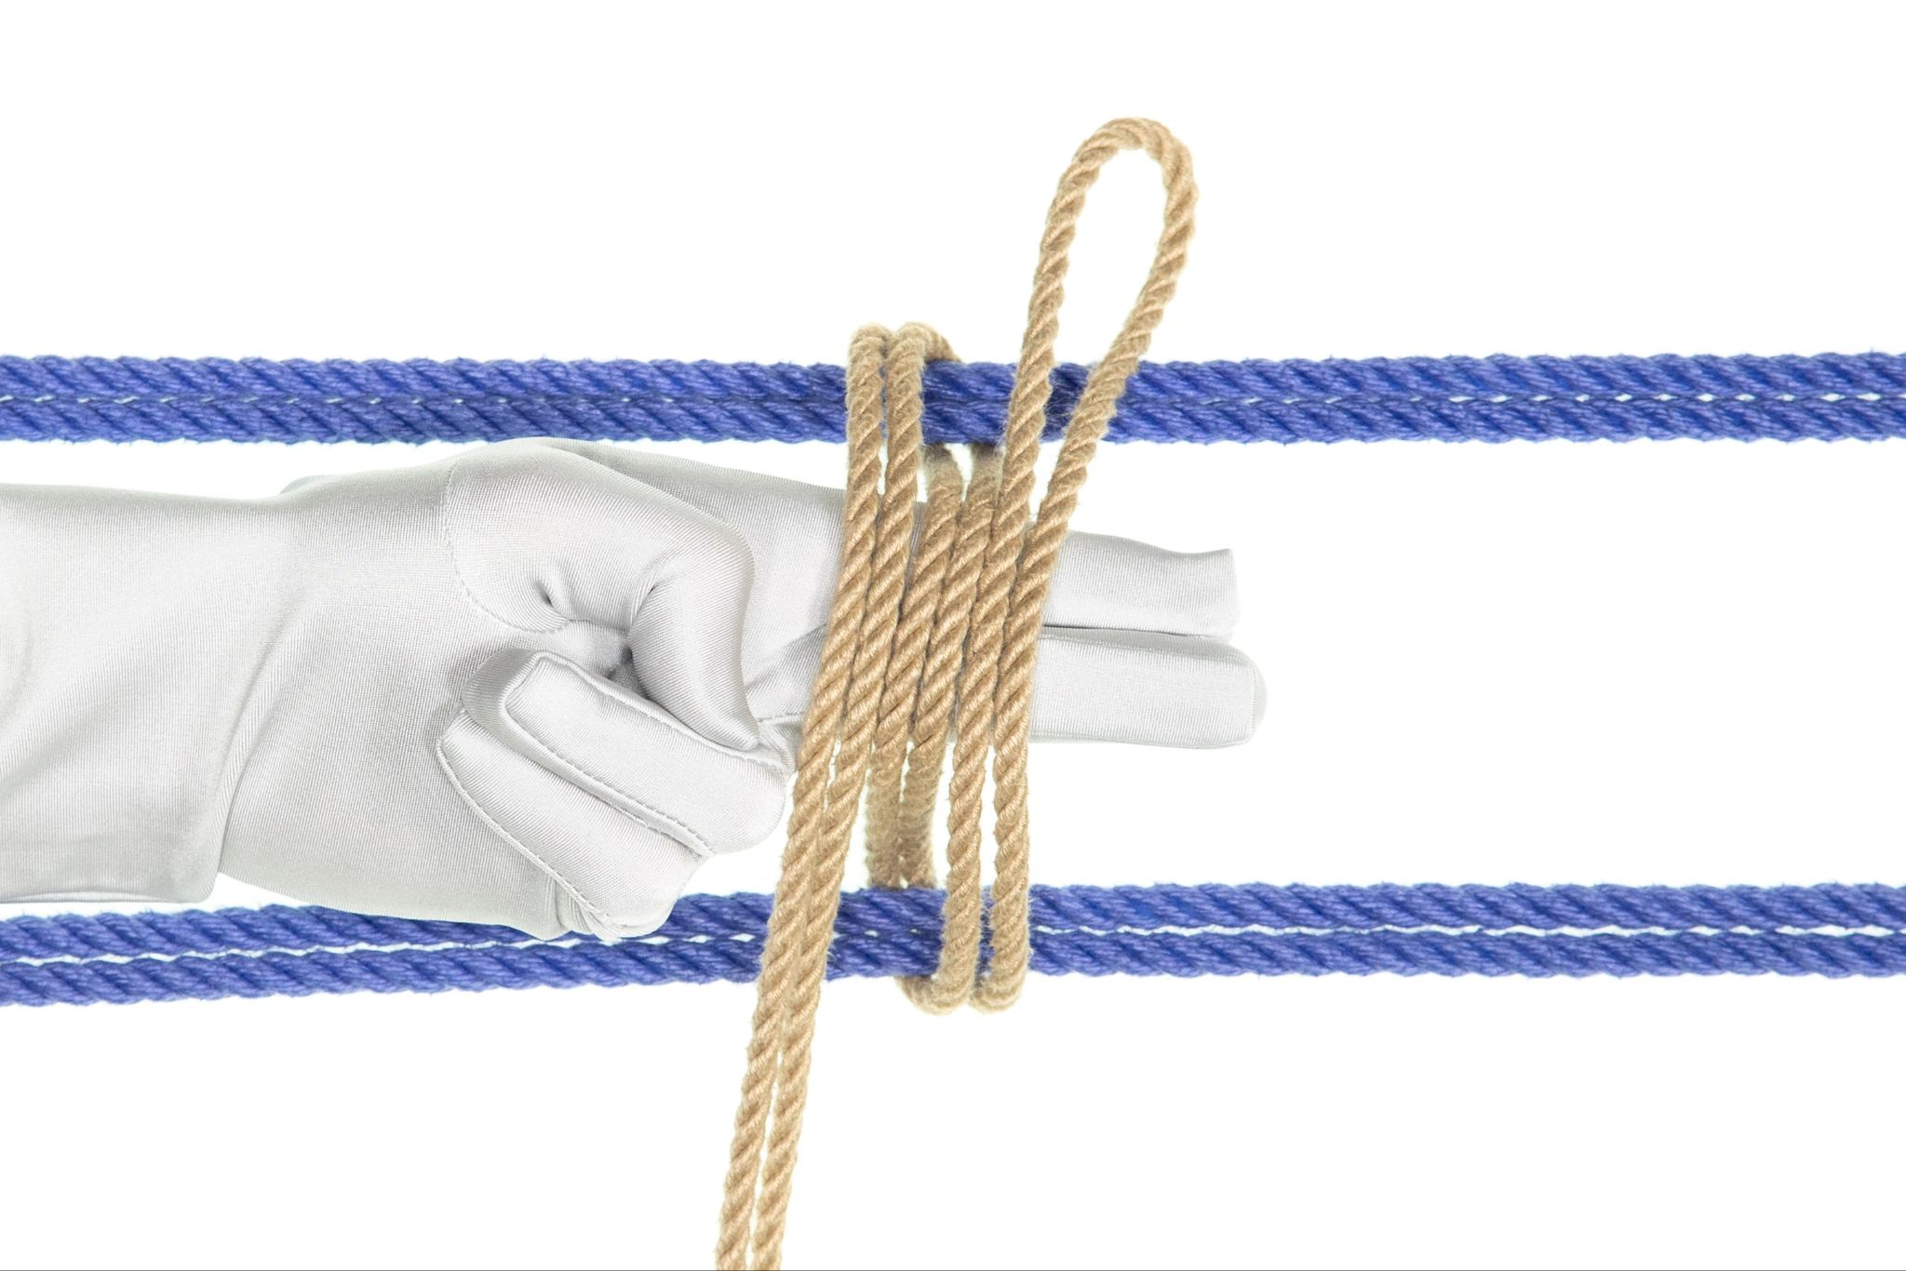
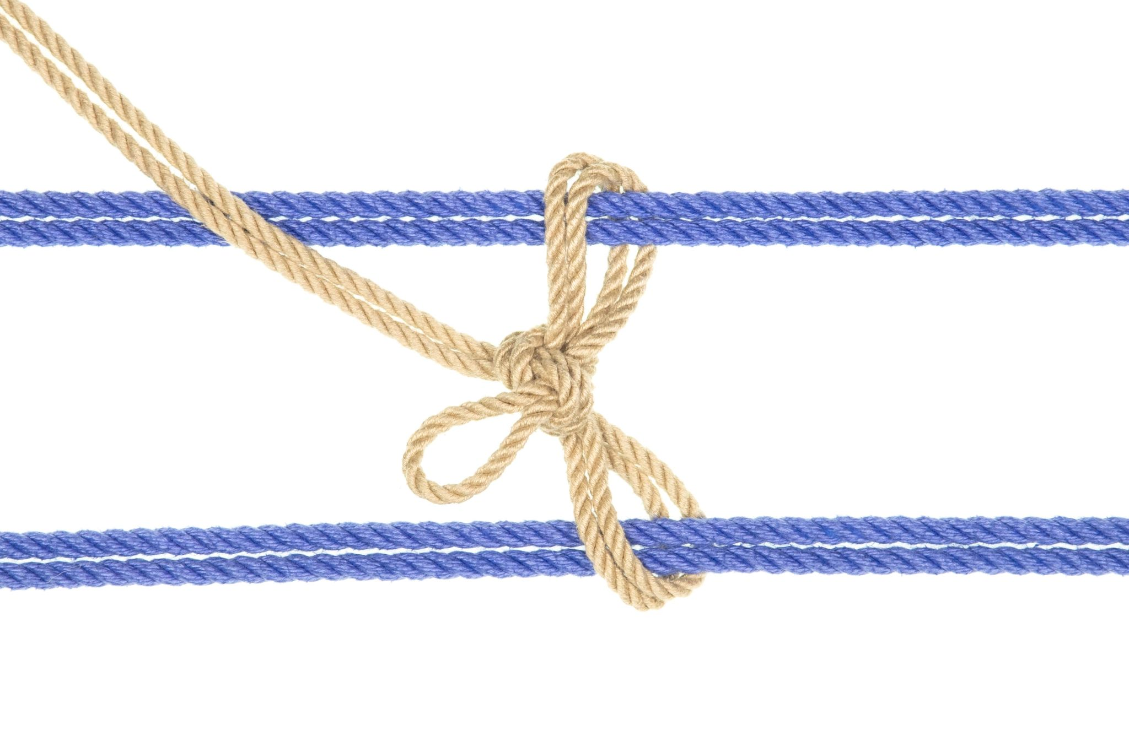
Attachments the y- hanger
Begin by wrapping both lines of harness as if you were tying a somerville, however lift the lower band while tying the knot to create a two column somerville.
The somerville Y-hanger

Slide 26
Lifting Technique
Use your legs (bend your knees!)
When possible “drop” your partner into the suspension rather than lifting them into it.
Don’t lift on a single bight. Use a double bight (i.e., “better bight” or “Australian bight”) instead to reduce repetitive stress on the bight. Carabiners and rappel rings also reduce friction stress.

Slide 27
Upline Management
Reduce friction and group your lines
Use carabineers and rappel rings
Create a pulley system (zig zag)
Limit your excess rope (max 3 wraps of rope before you switch to another carabiner)
Dealing with Jams
Picking
Lifting
Using another upline to unjam it
In rare cases, use safety shears

Slide 28
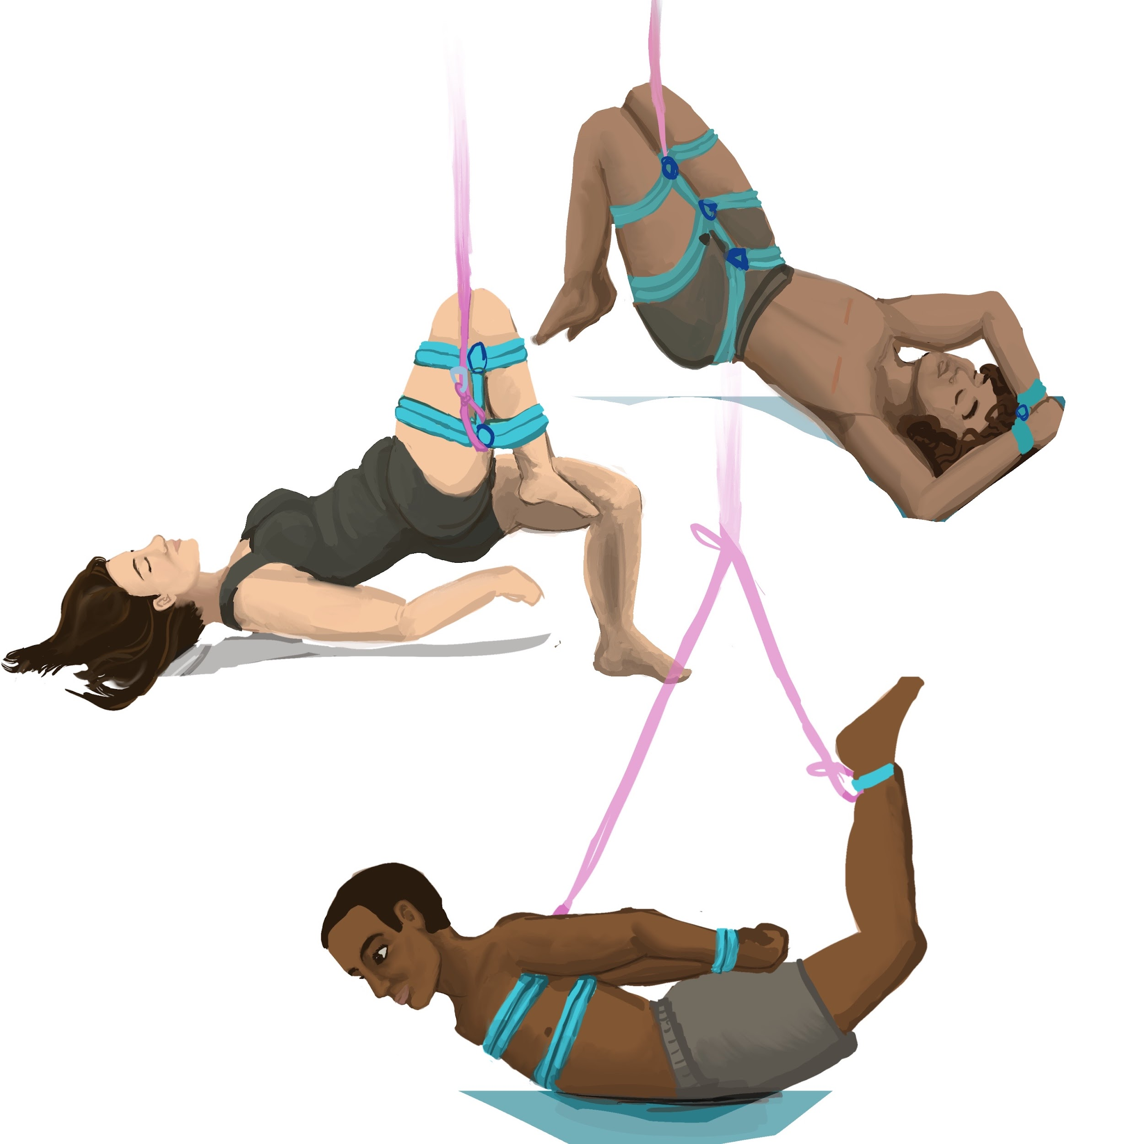
Partials to try
Forced forward fold
Hog-tie
The reclined Mermaid (keep chest on ground)
Futo (keep chest on ground)

Slide 29
Exercise: tie your first upline on your partner.
Notes:
Tie chest kneeling

Slide 30
Check in questions
Has your harness moved up or down?
Are the marks even?
Did your uplines jam?
Could you reach everything you needed to while tying?
How can you get your partner down safely?

Slide 31
The bend-over
Any kind of hip harness which can be grabbed from the back
Tie the wrists to ankles loosely.
Allows for penetration, impact play and predicaments
If the bottom does fall over they can be easily righted and released.

Slide 32
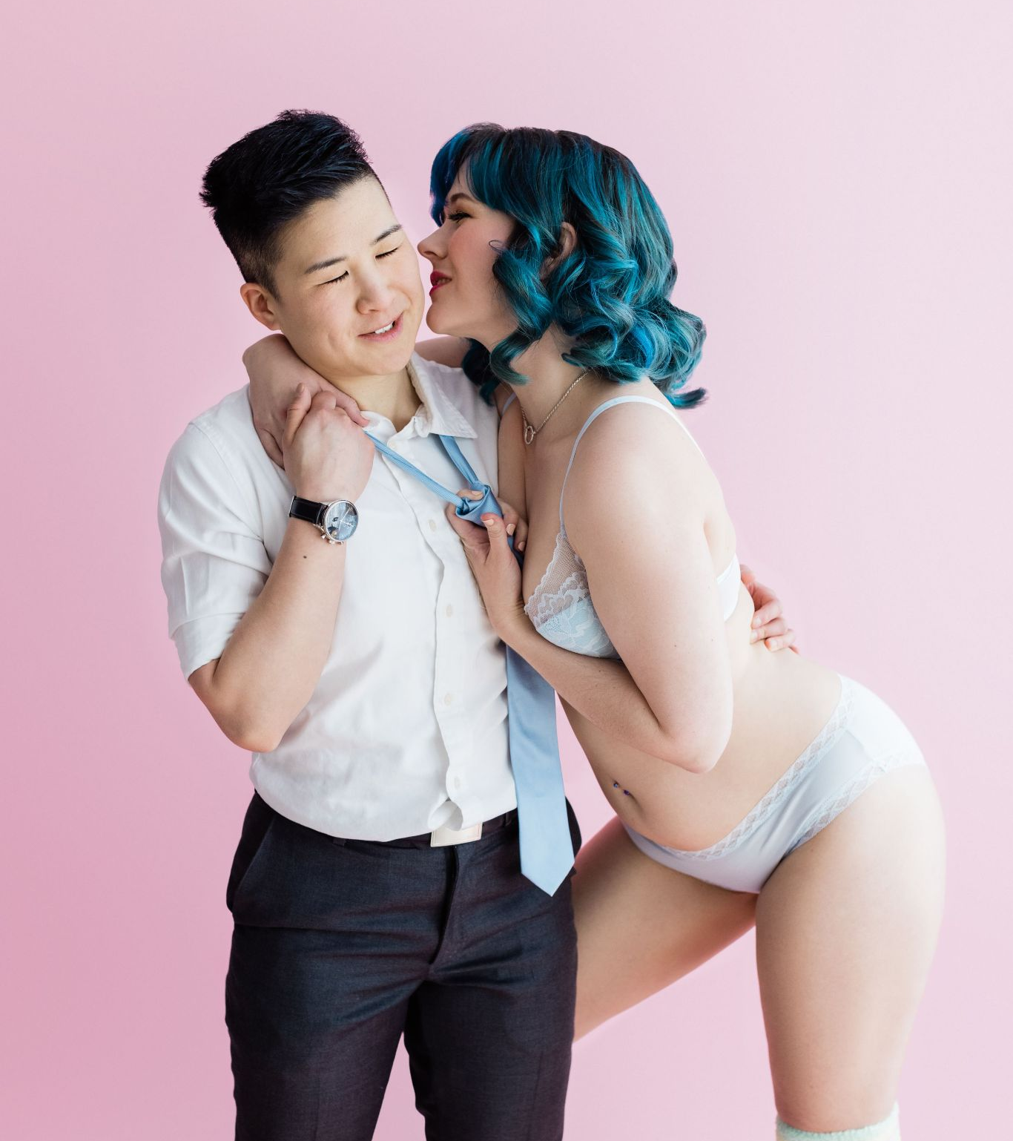
Make time to connect
You are always limited by your skills. When doing something new, you need to make time before or after you practice these skills to play.
Tip:
Use the rope to manipulate your partner’s body. Lift, twist, or pull to create sensations.

Slide 33
Managing your bottom
Have your bottom hold onto the ring not the rope.
Lean against your bottom to ensure they don't spin when lifted.
When tying place their limb against your body to help them keep it steady.
A scarf can be a nice way to provide support for your bottom’s head… just attach the scarf to a rope and attach it to your hard point.
Bottoms shouldn’t lift limbs on their own because it introduces slack into the upline, instead they should shift their weight into other limbs to make the limb easier to to lift.

Slide 34
Exercise:
Tops: hog tie with an upline
Bottoms: timer exercise

Slide 35
Triaging session
Bottoms need to learn how to triage sensations in their body and communicate it efficiently, much like a nurse in the ER knows to ignore the screaming baby and bring the man with half his face drooping first…not because he’s loud but because he’s having a stroke and it needs to be prioritized.
Some questions to ask about a new tie:
o Where am I going to feel pressure from the tie?
o What is the load placement and body position of the tie?
o Does it restrict breathing?

Slide 36
The timer exercise
One thing bottoms are often asked is “How long do you have in this tie/position?” The timer exercise helps us determine how long we actually have.
When giving feedback it’s helpful to frame it’s urgency for the Top:
o I need this changed now. I feel dizzy.
o When you have a moment I’d like my chest line dressed soon.
o I might need to have my ankle lowered later.
And remember … don’t panic!

Slide 37
The hog tie
Hog ties can be challenging on the ground, but if you add an upline they can be really challenging!
Hogties come in different styles, but we’re recommending attaching the back of a chest harness to the ankles, then lifting from there.
Be sure to to check in with your bottom regularly, as this can be stressful on the lower back.

Slide 38
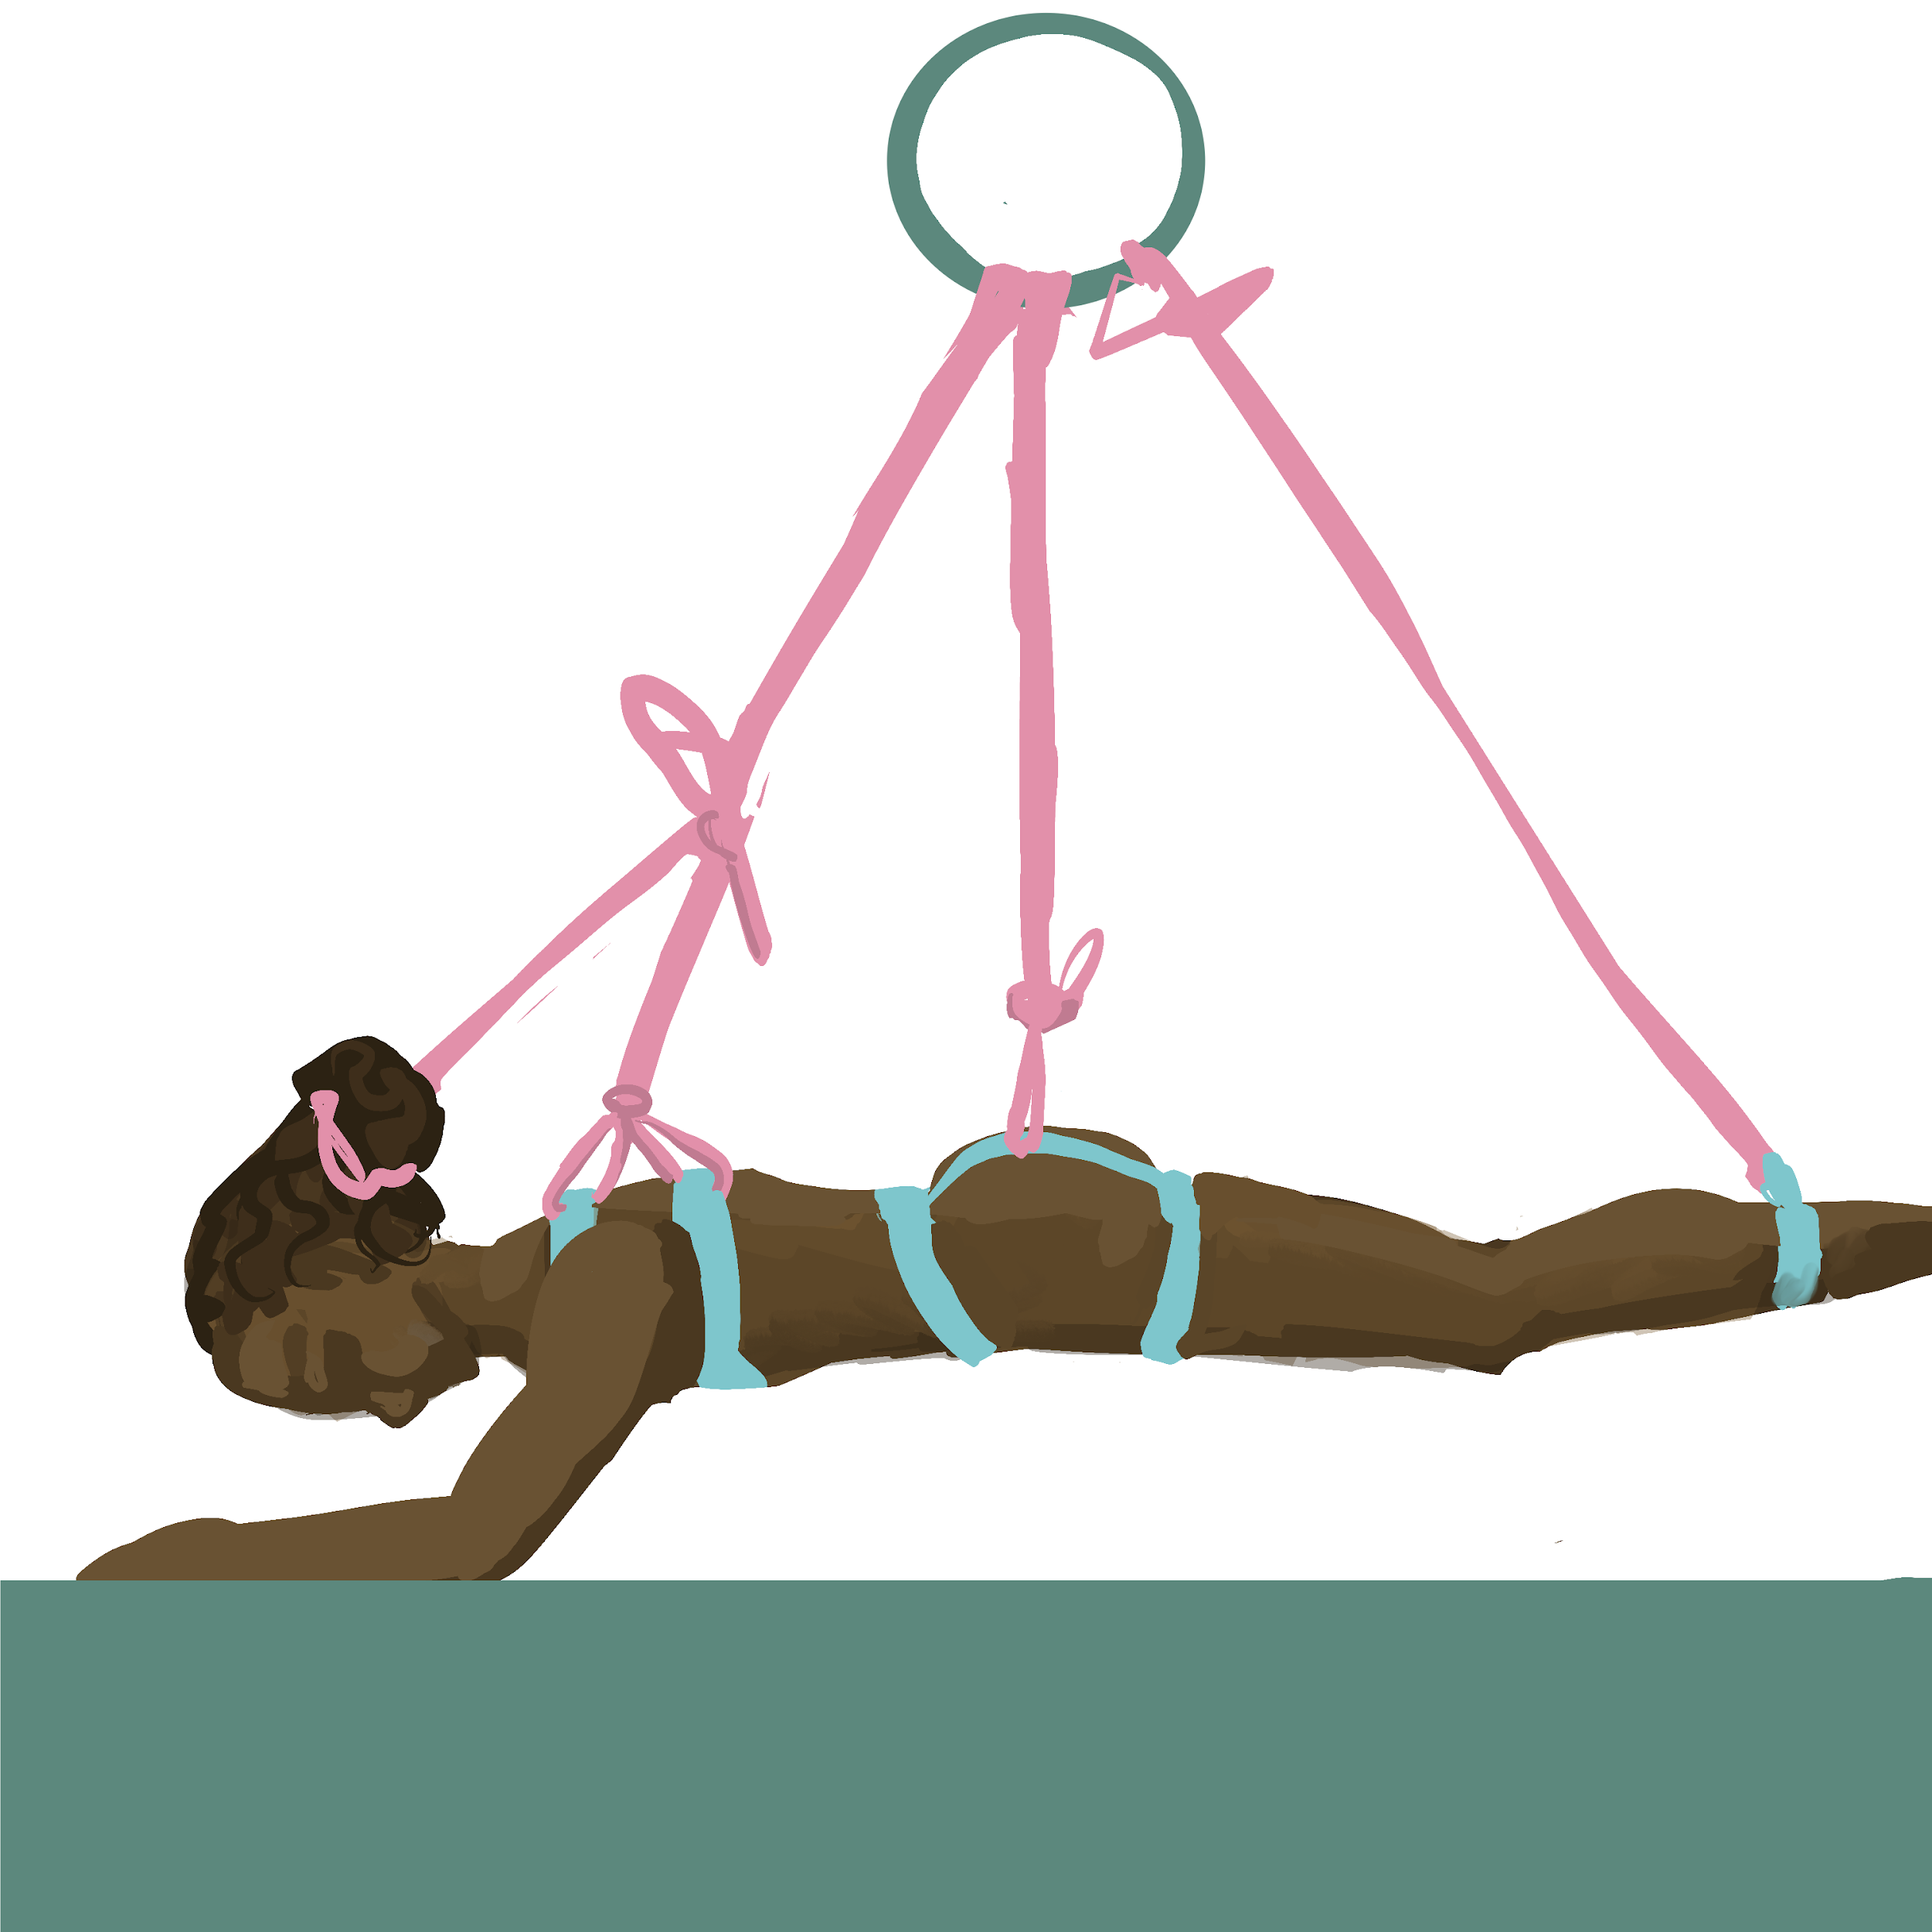
The sugar glider
This chest and hip harness combination allows you to practice both harnesses and two uplines
Your bottom is in a doggy position allowing them to control when they lean into the rope. (This also makes the position fuckable.)
To turn it into a full suspension, add both ankles.

Slide 39
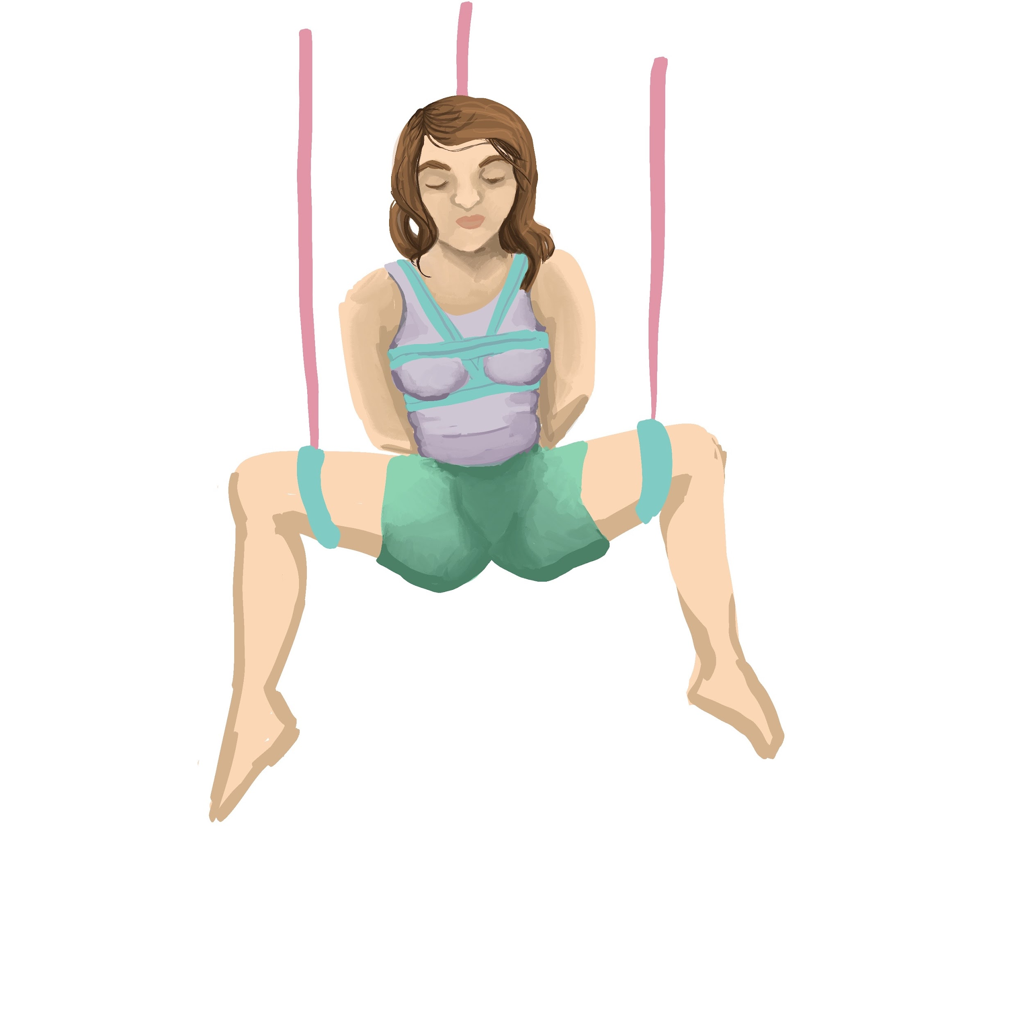
The chair/M position
In a chair position, the chest and two thigh cuffs provide support.
A hip harness can be used for additional support
First tie off the chest, then tie each leg
You may find the bottom prefers the legs higher or lower.
This is a good position for the bottom to be penetrated if desired.

Slide 40
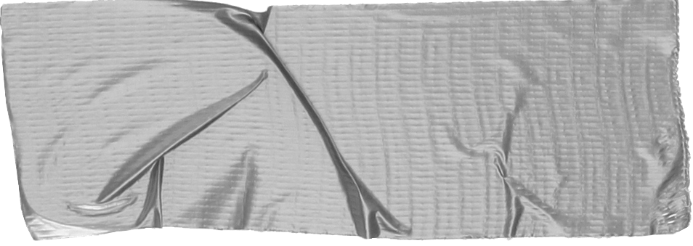
Good luck!
For more (free) tips, go to
Remedial Ropes
Full Circle Kink
Shibari study
The Duchy
Created by Magpie Kink Education
Special thanks to Full Circle Kink and the Seattle Instructors Collective for feedback, review and photos of upline attachments.
We highly recommend Anatomy for Bondage and Technical Rigging by Full Circle Kink as supplementary classes.

